Slide 1

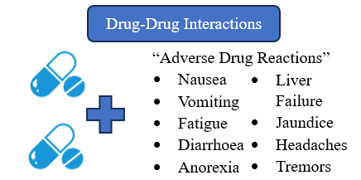
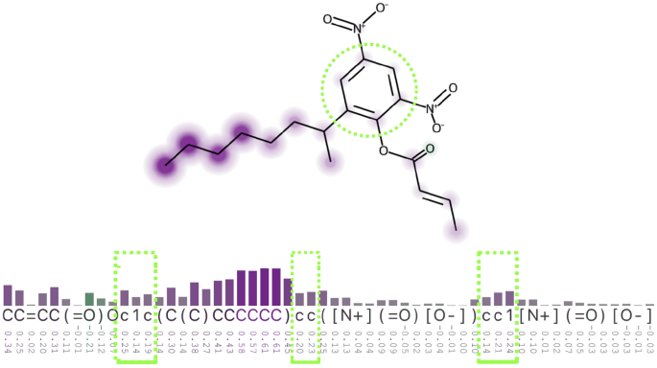

Developing an explainable deep learning model for drug-drug interaction prediction
S4203822 Marcus Abraham
This research endeavours to address the challenge of enhancing the interpretability of deep learning algorithms in the field of drug-drug interaction prediction, to increase trust in models, and enable wider adoption by healthcare practitioners. This will reduce risk to human life, and costs for pharmaceutical companies performing clinical trials.
How to increase explainability of deep learning algorithms for drug-drug interaction prediction, to improve reliability and reduce patient risk?
To investigate current deep learning approaches for drug-drug interaction prediction.
To develop a new explainable machine learning model for drug side effect prediction.
To evaluate the developed model, measuring its accuracy and explainability.
To validate the developed model on unseen data.
Overview
Problem Statement
Objectives
Related Work | Summary
Factors affecting the development of adverse drug reactions (Review article) (Alomar, 2013) | Gives an overview of what adverse drug reactions are, and what factors cause them. This first introduces drug interactions.
XSMILES: interactive visualization for molecules, SMILES and XAI attribution scores (Heberle et al., 2023) | Proposes XSMILES, an interactive visualization technique, to explore substructure importance for property prediction.
Application of artificial intelligence and machine learning in early detection of adverse drug reactions (ADRs) and drug-induced toxicity (Yang and Kar, 2023) | Provides a recent review of the current methods for ADR prediction. A lack of interpretability/explainability in deep learning methods is highlighted.
DDI-GCN: Drug-drug interaction prediction via explainable graph convolutional networks (Zhong et al., 2023) | Suggests a Graph Convolutional Neural Network approach to DDI, with visualisation for substructure importance, all presented in a GUI.
Drug-Drug Interactions
What are the current deep learning models used for drug-drug interaction prediction?
How can deep learning models be made more explainable?
What are the best methods of measuring accuracy and explainability in deep learning models?
How can a deep learning model be made more robust to unseen data?
Questions
The aim is to develop an accurate deep learning model for drug-drug interaction prediction while emphasizing explainability in the results. This entails leveraging both the predictive power of deep learning algorithms and explainable AI methods to enhance the models explain-ability.
Aim
XSMILES
Visualisation
References
Through these components, the research aims to contribute to the advancement of drug-drug side effect prediction by creating a model that combines deep learning predictive capabilities with a high degree of explainability. This will be done by presenting a heatmap of chemical substructures relating to ADR’s in a usable GUI.
Summary
Substructures related to adverse reactions within drugs will be identified with a heatmap, using techniques such as XSMILES (Heberle et al., 2023, p. 3).

